Slide 1
PAAS Provision Overview

Slide 2
Agenda
Stratus Cloud Stack
Stratus Regular Pool View
PaaS Provision Architecture
Demo
Vision
Reference

Slide 3
Cloud Technology Stack
Cloud Consumers
CMPaaS, Portal, CLI, Eclipse, python, perl, curl, browser, …
Cloud Services
PaaS: Platform Lifecycle Mgmt, Software Deployment, etc.
IaaS: Virtual Environment, Cluster, Pool, Compute, etc.
Framework Services
ODB/CMS
Auth&Auth, Policy Mgmt,
AMQ, CAL, etc.
Infrastructure Management Services
DNS, LB, Compute, Storage, IP, IMG Mgmt, RAS

Slide 4
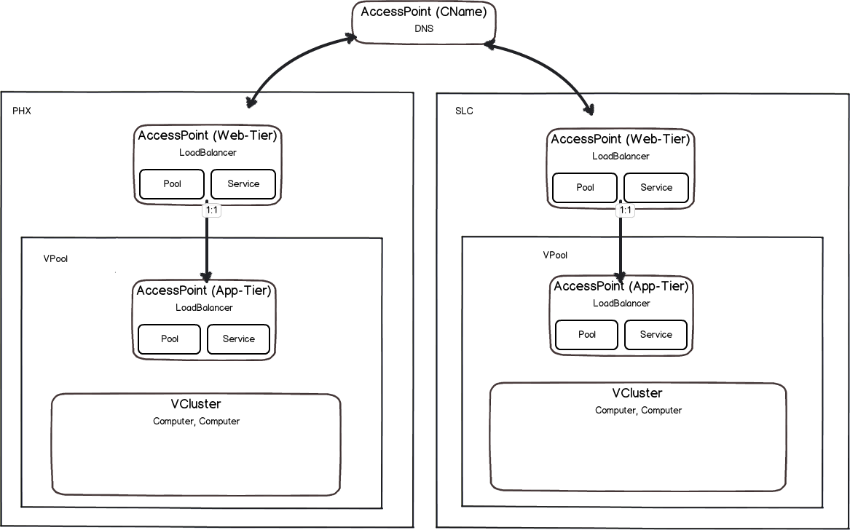
Stratus Regular Production Pool View
1%
99%

Slide 5
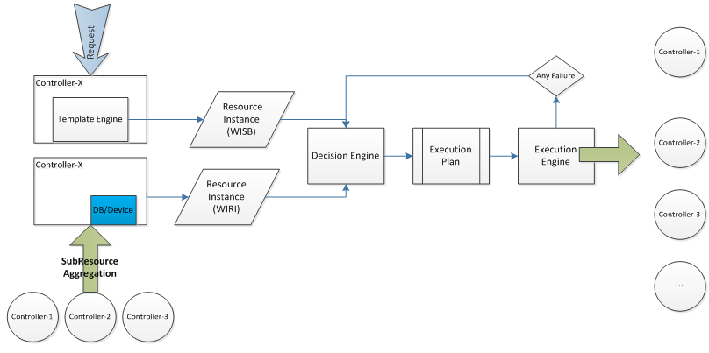
PaaS Provision Architecture:Topology Driven
Notes:
Use specified controller

Slide 6
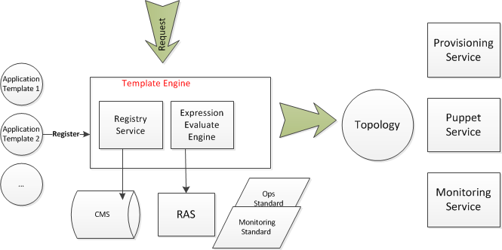
Feature Template to topology

Slide 7
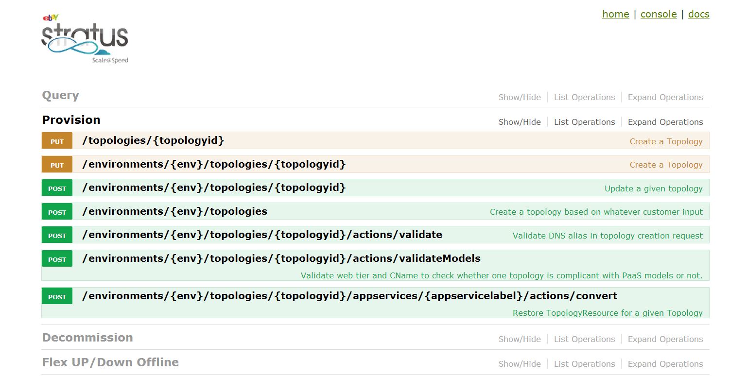
PaaS APIs
http://cmtopology.stratus.phx.ebay.com/help/console.html
Notes:
http://cmtopology.stratus.phx.ebay.com/help/console.html
Add a link in the slice

Slide 8
Demo
Self Service,
Web-Tier,
SSL,
CNAME,
Public VIP,
Multi DC support
Extend existing topology to a new data center
Generic Pool support,
Flex up/down

Slide 9
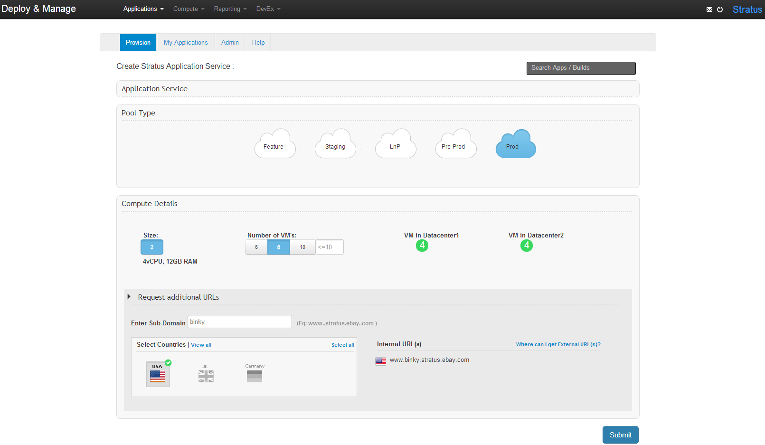
Self Service Provisioning
Notes:
https://cmportal.vip.ebay.com/_PortalWebApp/login

Slide 10
Web Tier Provisioning
Brand new topology provisioning with HTTP only
Brand new topology provisioning with HTTP and HTTPS
Adding HTTPS for existing topology

Slide 11
Adding HTTPS to Existing Topology
Example request for adding HTTPS to resource service pool
PUT http://cmtopology.stratus.phx.ebay.com/environments/ENVkwrg2y1ik3/topologies/ ressvc-topo/actions/addHttps
{
"portmap":"443:8082"
}

Slide 12
Brand New Topology Provisioning with HTTP and HTTPS
Example request for provisioning payment topology with HTTP and HTTPS
PUT http://cmtopology.stratus.phx.ebay.com/environments/ENV6opsknrpko/topologies/wmspay149-topo
{
"resources" : {
"cluster-1" : {
"type" : "Cluster",
"attributes" : {
"availabilityZone" : "PHX:PHX02"
}
}
},
"type" : "topology",
"attributes" : {
"applicationName" : "paasdemo",
"consumerID" : "ebay-marketplace-consumerid:213db066-7984-4a52-a843-c84150c02c27",
"applicationType" : "raptor",
"portmaps":["80:8080", "443:8082"],
"securePorts":["443"],
"architecture" : "r1",

Slide 13
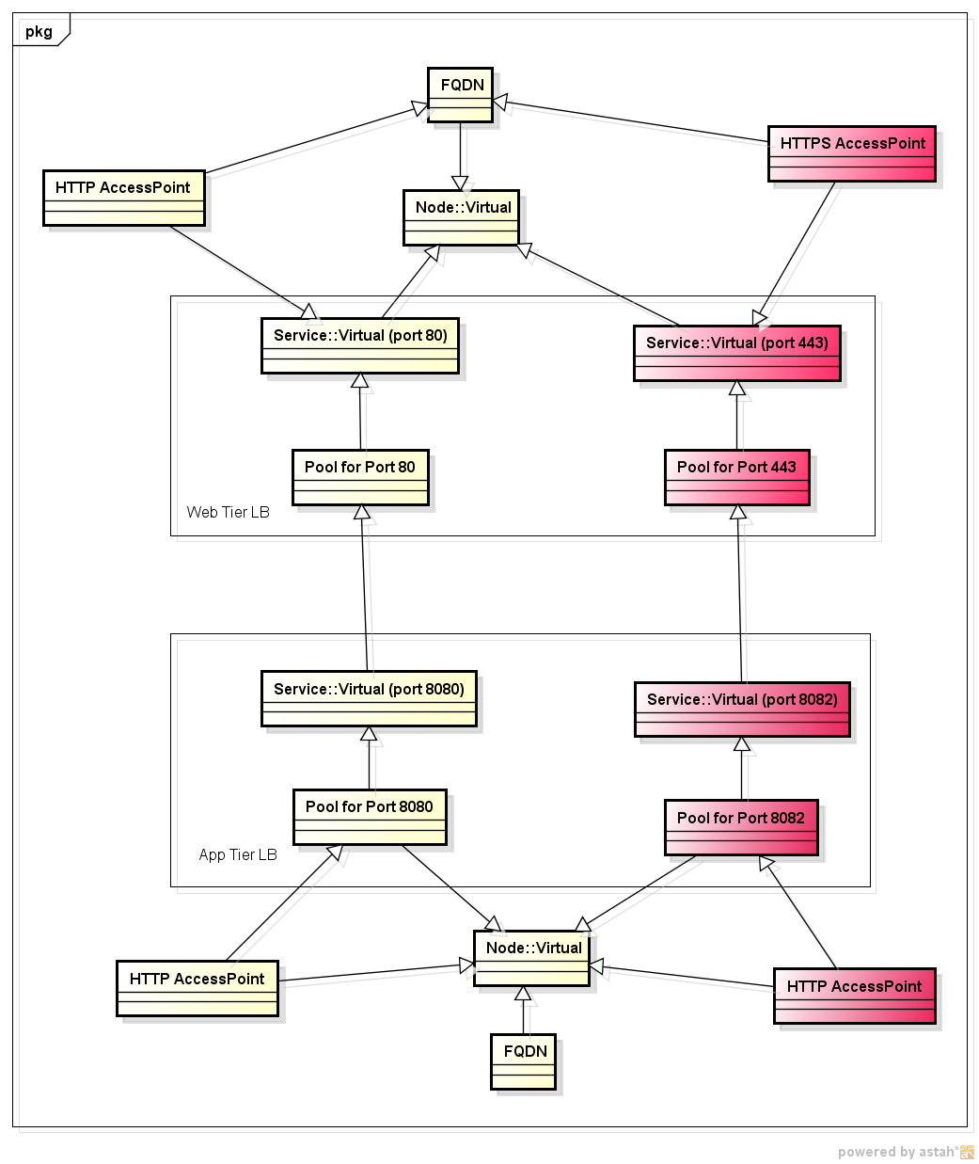
App Tier & Web Tier Models with HTTP & HTTPS

Slide 14
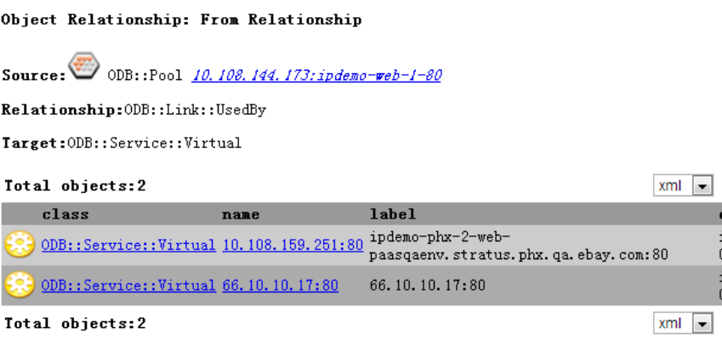
Enable Web Tier Public IP for Existing Topology
POST http://cmtopology.stratus.phx.ebay.com/topologies/ipdemo-topo:PaaSQAEnv/actions/enableWebTierPublicIp
Notes:
http://cms.cloud.qa.ebay.com/jodbweb/odb.do?type=relationship&view=object&name=10.108.144.173:ipdemo-web-1-80&relationtype=ODB::Link::UsedBy&targettype=ODB::Service::Virtual

Slide 15
CName Update
Example request for hundreds of CNames creation for payment service
PUT http://cmtopology.stratus.phx.ebay.com/environments/ENV6opsknrpko/topologies/gspunia89-topo/cnames
["payments.gsp20.stratus.qa.ebay.com","galleryplus.gsp20.stratus.qa.ebay.com","bulksell.gsp20.stratus.qa.ebay.com","offer.gsp20.stratus.qa.ebay.com","feedback.gsp20.stratus.qa.ebay.com","pay.IN.gsp20.stratus.qa.ebay.com","givingworks.gsp20.stratus.qa.ebay.com","ocs.gsp20.stratus.qa.ebay.com","rewards.gsp20.stratus.qa.ebay.com","mesgmy.gsp20.stratus.qa.ebay.com","my.gsp20.stratus.qa.ebay.com","payproc.gsp20.stratus.qa.ebay.com","stores.gsp20.stratus.qa.ebay.com","eazye1.gsp20.stratus.qa.ebay.com","cgi.gsp20.stratus.qa.ebay.com","scat.gsp20.stratus.qa.ebay.com","cgi5.gsp20.stratus.qa.ebay.com","shop.gsp20.stratus.qa.ebay.com","orders.IN.gsp20.stratus.qa.ebay.com","res.gsp20.stratus.qa.ebay.com","signin.gsp20.stratus.qa.ebay.com","eoa.gsp20.stratus.qa.ebay.com","frame.gsp20.stratus.qa.ebay.com","shiptrack.gsp20.stratus.qa.ebay.com","ir.gsp20.stratus.qa.ebay.com","return.gsp20.stratus.qa.ebay.com","floater1.gsp20.stratus.qa.ebay.com","scgi.gsp20.stratus.qa.ebay.com","myworld.gsp20.stratus.qa.ebay.com","secureir.gsp20.stratus.qa.ebay.com","blogs.gsp20.stratus.qa.ebay.com","eazye.gsp20.stratus.qa.ebay.com","eazye2.gsp20.stratus.qa.ebay.com","pages.gsp20.stratus.qa.ebay.com","cs.gsp20.stratus.qa.ebay.com","cgi6.gsp20.stratus.qa.ebay.com","syi.gsp20.stratus.qa.ebay.com","metrics.gsp20.stratus.qa.ebay.com","k2bbulk.gsp20.stratus.qa.ebay.com","contact.gsp20.stratus.qa.ebay.com", … "search-completed.gsp20.stratus.qa.ebay.com"]
Notes:
Fast horses vs. cars

Slide 16
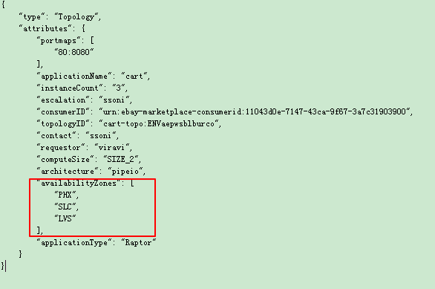
Multiple DC support
Service redundancy improves availability. If the pool is cross colo and one colo is down, it does not affect our business fatally.
As of now, There are three data centers available for provision. Such as PHX, SLC and LVS. If new data center is set up in the future, PAAS can make use of it seamlessly.
Notes:
PUT: http://cmtopology.stratus.phx.ebay.com/topologies/cart-topo:ENVaepwsblburco
{
"type": "Topology",
"attributes": {
"portmaps": [
"80:8080"
],
"applicationName": "cart",
"instanceCount": “3",
"escalation": "ssoni",
"consumerID": "urn:ebay-marketplace-consumerid:11043d0e-7147-43ca-9f67-3a7c31903900",
"topologyID": "cart-topo:ENVaepwsblburco",
"contact": "ssoni",
"requestor": "viravi",
"computeSize": "SIZE_2",
"architecture": "r1",
"availabilityZones": [
"PHX",
"SLC",
"LVS"
],
"applicationType": "Raptor"
}
}

Slide 17
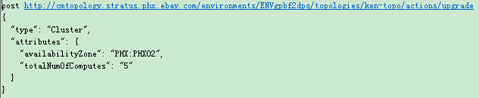
Upgrade existing topology to span a new DC
For capacity add, we can achieve it by two ways:
Flex it up
If there is no compute resource available in the existing data centers, then upgrade the existing topology to new data center.
Notes:
https://wiki.vip.corp.ebay.com/display/CLOUD/Upgrade+Existing+Topology+API
post http://cmtopology.stratus.phx.ebay.com/environments/ENVgpbf2dpq/topologies/ken-topo/actions/upgrade
{
"type": "Cluster",
"attributes": {
"availabilityZone": "PHX:PHX02",
"totalNumOfComputes": "5"
}
}

Slide 18
Flex up and Flex Down
Somehow customers will think the capacity for the pool is sufficient/insufficient, in this case, they can use flex down or flex up function provided by PAAS.
As of now, CMPaaS has already made integration with flex up.
Notes:
https://wiki.vip.corp.ebay.com/display/CLOUD/PaaS+Provisioning+API+-Flex+on+instanceCount

Slide 19
Post
http://cmtopology.stratus.phx.ebay.com/environments/ENVgpbf2dpq/appservices/jiangh1-app/instanceCount
{
"PHX":"2"
}

Slide 20
Generic Pool Provision
Sometimes customers do not require raptor pool, they only ask for some computes, without any load balancer configuration and DNS configuration. PAAS supports it by different application types.
Supported application types:
Raptor
Qlio (topology is similar to raptor except ecv check)
Clusteronly
Agile support for new application types

Slide 21
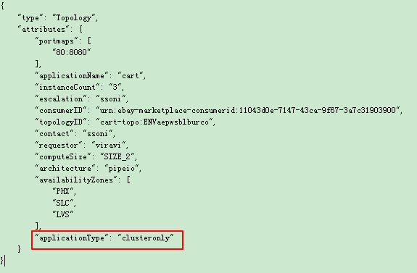
Notes:
Application type: raptor, qlio, clusteronly

Slide 22
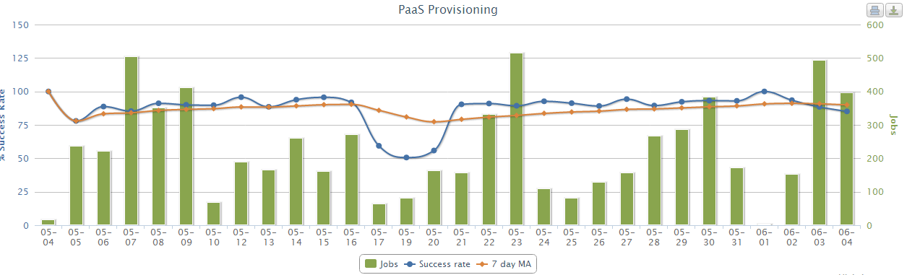
PAAS Provision Reliability Chart
http://ceilometer.stratus.phx.ebay.com/reliability

Slide 23
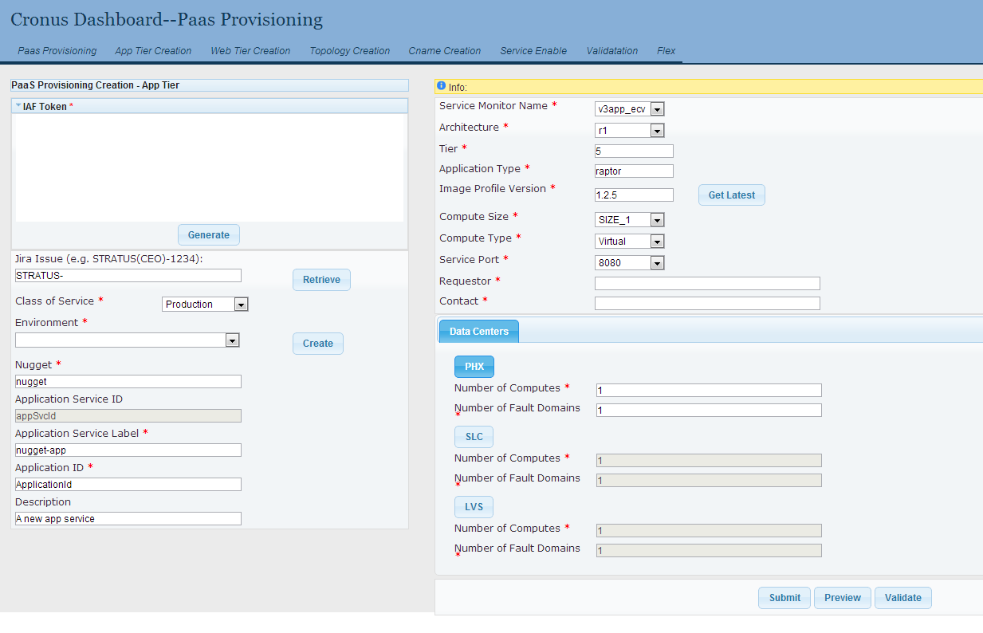
Provision Dashboard
http://ironman-app.stratus.phx.ebay.com:8080/dashboard/paas_provision/provision

Slide 24
Ongoing Goals
Q2: PaaS ODB and CMS dual write
PaaS integration with new Restful LB service and DNS service
Q3: PaaS CMS read and write
PaaS off ODB

Slide 25
Vision
Generic topology
Integrate with puppet service to do software preinstall.
Monitoring integration
Elastic PAAS

Slide 26
Reference
API document http://cmtopology.stratus.phx.ebay.com/help/console.html
PAAS Wiki https://wiki.vip.corp.ebay.com/display/CLOUD/Cloud+V3+Vertical

